Slide 1
Week 12: Binary Search Tree
WIA1002/WIB1002/WXES1117:
Data Structure

Slide 2
Objectives
To design and implement a binary search tree.
To represent binary trees using linked data structures.
To search an element in binary search tree.
To insert an element into a binary search tree.
To traverse elements in a binary tree.
To delete elements from a binary search tree.

Slide 3
Binary Trees
A list, stack, or queue is a linear structure that consists of a sequence of elements. A binary tree is a hierarchical structure. It is either empty or consists of an element, called the root, and two distinct binary trees, called the left subtree and right subtree.

Slide 4
Terms:
Length of path – num of edges in the path (eg:60-45 → 2)
Depth – length of path from root to node (eg:60 → 0; 55→1)
Level – set of all nodes at a given depth (e.g:55,100)
Siblings – nodes share same parent node (eg: 45-57)
Left child- root of the left subtree of a node
Leaf – node without children (eg: A)
Height – length of path fr root node to its further leaf + 1 (eg:3)

Slide 5
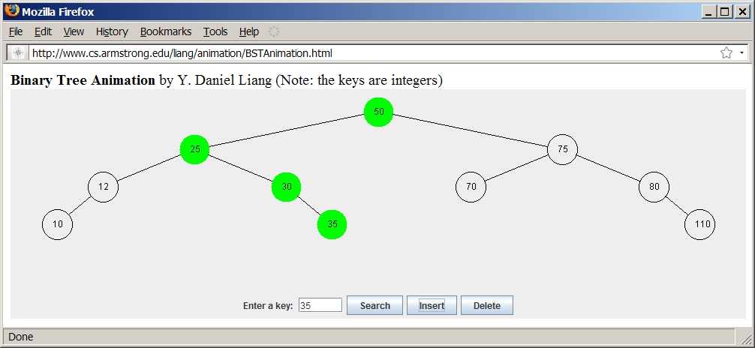
See How a Binary Tree Works
www.cs.armstrong.edu/liang/animation/BSTAnimation.html

Slide 6
Binary Tree Terms
A special type of binary tree called a binary search tree is often useful.
A binary search tree (with no duplicate elements) has the property that for every node in the tree the value of any node in its left subtree is less than the value of the node and the value of any node in its right subtree is greater than the value of the node.

Slide 7
Representing Binary Trees
A binary tree can be represented using a set of linked nodes. Each node contains a value and two links named left and right that reference the left child and right child, respectively as shown below.
class TreeNode<E> {
E element;
TreeNode<E> left;
TreeNode<E> right;
public TreeNode(E o) {
element = o;
}
}

Slide 8
Create node
Variable root refers to the root node of the tree.
If tree is empty, root is null.
Create root node:
TreeNode<Integer> root = new TreeNode<Integer>(new Integer(60));
Create left child node:
root.left = new TreeNode<Integer>(new Integer(55));
Create right child node:
root.right = new TreeNode<Integer>(new Integer(100));

Slide 9
Searching an Element in a Binary Tree
public boolean search(E element) {
TreeNode<E> current = root; // Start from the root
while (current != null)
if (element < current.element) {
current = current.left; // Go left
}
else if (element > current.element) {
current = current.right; // Go right
}
else // Element matches current.element
return true; // Element is found
return false; // Element is not in the tree
}

Slide 10
Inserting an Element to a Binary Tree
If a binary tree is empty, create a root node with the new element.
Otherwise, locate the parent node for the new element node.
If the new element is less than the parent element, the node for the new element becomes the left child of the parent.
If the new element is greater than the parent element, the node for the new element becomes the right child of the parent. Here is the algorithm:

Slide 11
Inserting an Element to a Binary Tree
if (root == null)
root = new TreeNode(element);
else {
// Locate the parent node
current = root;
while (current != null)
if (element value < the value in current.element) {
parent = current;
current = current.left;
}
else if (element value > the value in current.element) {
parent = current;
current = current.right;
}
else
return false; // Duplicate node not inserted
// Create the new node and attach it to the parent node
if (element < parent.element)
parent.left = new TreeNode(elemenet);
else
parent.right = new TreeNode(elemenet);
return true; // Element inserted
}
Insert 101 into the following tree.

Slide 12
Trace Inserting 101 into the following tree
if (root == null)
root = new TreeNode(element);
else {
// Locate the parent node
current = root;
while (current != null)
if (element value < the value in current.element) {
parent = current;
current = current.left;
}
else if (element value > the value in current.element) {
parent = current;
current = current.right;
}
else
return false; // Duplicate node not inserted
// Create the new node and attach it to the parent node
if (element < parent.element)
parent.left = new TreeNode(elemenet);
else
parent.right = new TreeNode(elemenet);
return true; // Element inserted
}
Insert 101 into the following tree.

Slide 13
Trace Inserting 101 into the following tree, cont.
if (root == null)
root = new TreeNode(element);
else {
// Locate the parent node
current = root;
while (current != null)
if (element value < the value in current.element) {
parent = current;
current = current.left;
}
else if (element value > the value in current.element) {
parent = current;
current = current.right;
}
else
return false; // Duplicate node not inserted
// Create the new node and attach it to the parent node
if (element < parent.element)
parent.left = new TreeNode(elemenet);
else
parent.right = new TreeNode(elemenet);
return true; // Element inserted
}
Insert 101 into the following tree.

Slide 14
Trace Inserting 101 into the following tree, cont.
if (root == null)
root = new TreeNode(element);
else {
// Locate the parent node
current = root;
while (current != null)
if (element value < the value in current.element) {
parent = current;
current = current.left;
}
else if (element value > the value in current.element) {
parent = current;
current = current.right;
}
else
return false; // Duplicate node not inserted
// Create the new node and attach it to the parent node
if (element < parent.element)
parent.left = new TreeNode(elemenet);
else
parent.right = new TreeNode(elemenet);
return true; // Element inserted
}
Insert 101 into the following tree.

Slide 15
Trace Inserting 101 into the following tree, cont.
if (root == null)
root = new TreeNode(element);
else {
// Locate the parent node
current = root;
while (current != null)
if (element value < the value in current.element) {
parent = current;
current = current.left;
}
else if (element value > the value in current.element) {
parent = current;
current = current.right;
}
else
return false; // Duplicate node not inserted
// Create the new node and attach it to the parent node
if (element < parent.element)
parent.left = new TreeNode(elemenet);
else
parent.right = new TreeNode(elemenet);
return true; // Element inserted
}
Insert 101 into the following tree.
101 < 60?

Slide 16
Trace Inserting 101 into the following tree, cont.
if (root == null)
root = new TreeNode(element);
else {
// Locate the parent node
current = root;
while (current != null)
if (element value < the value in current.element) {
parent = current;
current = current.left;
}
else if (element value > the value in current.element) {
parent = current;
current = current.right;
}
else
return false; // Duplicate node not inserted
// Create the new node and attach it to the parent node
if (element < parent.element)
parent.left = new TreeNode(elemenet);
else
parent.right = new TreeNode(elemenet);
return true; // Element inserted
}
Insert 101 into the following tree.
101 > 60?

Slide 17
Trace Inserting 101 into the following tree, cont.
if (root == null)
root = new TreeNode(element);
else {
// Locate the parent node
current = root;
while (current != null)
if (element value < the value in current.element) {
parent = current;
current = current.left;
}
else if (element value > the value in current.element) {
parent = current;
current = current.right;
}
else
return false; // Duplicate node not inserted
// Create the new node and attach it to the parent node
if (element < parent.element)
parent.left = new TreeNode(elemenet);
else
parent.right = new TreeNode(elemenet);
return true; // Element inserted
}
Insert 101 into the following tree.
101 > 60 true

Slide 18
Trace Inserting 101 into the following tree, cont.
if (root == null)
root = new TreeNode(element);
else {
// Locate the parent node
current = root;
while (current != null)
if (element value < the value in current.element) {
parent = current;
current = current.left;
}
else if (element value > the value in current.element) {
parent = current;
current = current.right;
}
else
return false; // Duplicate node not inserted
// Create the new node and attach it to the parent node
if (element < parent.element)
parent.left = new TreeNode(elemenet);
else
parent.right = new TreeNode(elemenet);
return true; // Element inserted
}
Insert 101 into the following tree.
101 > 60 true

Slide 19
Trace Inserting 101 into the following tree, cont.
if (root == null)
root = new TreeNode(element);
else {
// Locate the parent node
current = root;
while (current != null)
if (element value < the value in current.element) {
parent = current;
current = current.left;
}
else if (element value > the value in current.element) {
parent = current;
current = current.right;
}
else
return false; // Duplicate node not inserted
// Create the new node and attach it to the parent node
if (element < parent.element)
parent.left = new TreeNode(elemenet);
else
parent.right = new TreeNode(elemenet);
return true; // Element inserted
}
Insert 101 into the following tree.
101 > 60 true

Slide 20
Trace Inserting 101 into the following tree, cont.
if (root == null)
root = new TreeNode(element);
else {
// Locate the parent node
current = root;
while (current != null)
if (element value < the value in current.element) {
parent = current;
current = current.left;
}
else if (element value > the value in current.element) {
parent = current;
current = current.right;
}
else
return false; // Duplicate node not inserted
// Create the new node and attach it to the parent node
if (element < parent.element)
parent.left = new TreeNode(elemenet);
else
parent.right = new TreeNode(elemenet);
return true; // Element inserted
}
Insert 101 into the following tree.
101 < 100 false

Slide 21
Trace Inserting 101 into the following tree, cont.
if (root == null)
root = new TreeNode(element);
else {
// Locate the parent node
current = root;
while (current != null)
if (element value < the value in current.element) {
parent = current;
current = current.left;
}
else if (element value > the value in current.element) {
parent = current;
current = current.right;
}
else
return false; // Duplicate node not inserted
// Create the new node and attach it to the parent node
if (element < parent.element)
parent.left = new TreeNode(elemenet);
else
parent.right = new TreeNode(elemenet);
return true; // Element inserted
}
Insert 101 into the following tree.
101 > 100 true

Slide 22
Trace Inserting 101 into the following tree, cont.
if (root == null)
root = new TreeNode(element);
else {
// Locate the parent node
current = root;
while (current != null)
if (element value < the value in current.element) {
parent = current;
current = current.left;
}
else if (element value > the value in current.element) {
parent = current;
current = current.right;
}
else
return false; // Duplicate node not inserted
// Create the new node and attach it to the parent node
if (element < parent.element)
parent.left = new TreeNode(elemenet);
else
parent.right = new TreeNode(elemenet);
return true; // Element inserted
}
Insert 101 into the following tree.
101 > 100 true

Slide 23
Trace Inserting 101 into the following tree, cont.
if (root == null)
root = new TreeNode(element);
else {
// Locate the parent node
current = root;
while (current != null)
if (element value < the value in current.element) {
parent = current;
current = current.left;
}
else if (element value > the value in current.element) {
parent = current;
current = current.right;
}
else
return false; // Duplicate node not inserted
// Create the new node and attach it to the parent node
if (element < parent.element)
parent.left = new TreeNode(elemenet);
else
parent.right = new TreeNode(elemenet);
return true; // Element inserted
}
Insert 101 into the following tree.
101 > 100 true

Slide 24
Trace Inserting 101 into the following tree, cont.
if (root == null)
root = new TreeNode(element);
else {
// Locate the parent node
current = root;
while (current != null)
if (element value < the value in current.element) {
parent = current;
current = current.left;
}
else if (element value > the value in current.element) {
parent = current;
current = current.right;
}
else
return false; // Duplicate node not inserted
// Create the new node and attach it to the parent node
if (element < parent.element)
parent.left = new TreeNode(elemenet);
else
parent.right = new TreeNode(elemenet);
return true; // Element inserted
}
Insert 101 into the following tree.
101 > 100 true

Slide 25
Trace Inserting 101 into the following tree, cont.
if (root == null)
root = new TreeNode(element);
else {
// Locate the parent node
current = root;
while (current != null)
if (element value < the value in current.element) {
parent = current;
current = current.left;
}
else if (element value > the value in current.element) {
parent = current;
current = current.right;
}
else
return false; // Duplicate node not inserted
// Create the new node and attach it to the parent node
if (element < parent.element)
parent.left = new TreeNode(elemenet);
else
parent.right = new TreeNode(elemenet);
return true; // Element inserted
}
Insert 101 into the following tree.
101 < 107 true

Slide 26
Trace Inserting 101 into the following tree, cont.
if (root == null)
root = new TreeNode(element);
else {
// Locate the parent node
current = root;
while (current != null)
if (element value < the value in current.element) {
parent = current;
current = current.left;
}
else if (element value > the value in current.element) {
parent = current;
current = current.right;
}
else
return false; // Duplicate node not inserted
// Create the new node and attach it to the parent node
if (element < parent.element)
parent.left = new TreeNode(elemenet);
else
parent.right = new TreeNode(elemenet);
return true; // Element inserted
}
Insert 101 into the following tree.
101 < 107 true

Slide 27
Trace Inserting 101 into the following tree, cont.
if (root == null)
root = new TreeNode(element);
else {
// Locate the parent node
current = root;
while (current != null)
if (element value < the value in current.element) {
parent = current;
current = current.left;
}
else if (element value > the value in current.element) {
parent = current;
current = current.right;
}
else
return false; // Duplicate node not inserted
// Create the new node and attach it to the parent node
if (element < parent.element)
parent.left = new TreeNode(elemenet);
else
parent.right = new TreeNode(elemenet);
return true; // Element inserted
}
Insert 101 into the following tree.
101 < 107 true

Slide 28
Trace Inserting 101 into the following tree, cont.
if (root == null)
root = new TreeNode(element);
else {
// Locate the parent node
current = root;
while (current != null)
if (element value < the value in current.element) {
parent = current;
current = current.left;
}
else if (element value > the value in current.element) {
parent = current;
current = current.right;
}
else
return false; // Duplicate node not inserted
// Create the new node and attach it to the parent node
if (element < parent.element)
parent.left = new TreeNode(elemenet);
else
parent.right = new TreeNode(elemenet);
return true; // Element inserted
}
Insert 101 into the following tree.
current is null now

Slide 29
Trace Inserting 101 into the following tree, cont.
if (root == null)
root = new TreeNode(element);
else {
// Locate the parent node
current = root;
while (current != null)
if (element value < the value in current.element) {
parent = current;
current = current.left;
}
else if (element value > the value in current.element) {
parent = current;
current = current.right;
}
else
return false; // Duplicate node not inserted
// Create the new node and attach it to the parent node
if (element < parent.element)
parent.left = new TreeNode(elemenet);
else
parent.right = new TreeNode(elemenet);
return true; // Element inserted
}
Insert 101 into the following tree.
101 < 107 true

Slide 30
Trace Inserting 101 into the following tree, cont.
if (root == null)
root = new TreeNode(element);
else {
// Locate the parent node
current = root;
while (current != null)
if (element value < the value in current.element) {
parent = current;
current = current.left;
}
else if (element value > the value in current.element) {
parent = current;
current = current.right;
}
else
return false; // Duplicate node not inserted
// Create the new node and attach it to the parent node
if (element < parent.element)
parent.left = new TreeNode(elemenet);
else
parent.right = new TreeNode(elemenet);
return true; // Element inserted
}
Insert 101 into the following tree.
101 < 107 true

Slide 31
Trace Inserting 101 into the following tree, cont.
if (root == null)
root = new TreeNode(element);
else {
// Locate the parent node
current = root;
while (current != null)
if (element value < the value in current.element) {
parent = current;
current = current.left;
}
else if (element value > the value in current.element) {
parent = current;
current = current.right;
}
else
return false; // Duplicate node not inserted
// Create the new node and attach it to the parent node
if (element < parent.element)
parent.left = new TreeNode(elemenet);
else
parent.right = new TreeNode(elemenet);
return true; // Element inserted
}
Insert 101 into the following tree.
101 < 107 true

Slide 32
Inserting 59 into the Tree
if (root == null)
root = new TreeNode(element);
else {
// Locate the parent node
current = root;
while (current != null)
if (element value < the value in current.element) {
parent = current;
current = current.left;
}
else if (element value > the value in current.element) {
parent = current;
current = current.right;
}
else
return false; // Duplicate node not inserted
// Create the new node and attach it to the parent node
if (element < parent.element)
parent.left = new TreeNode(elemenet);
else
parent.right = new TreeNode(elemenet);
return true; // Element inserted
}

Slide 33
Tree Traversal
Tree traversal is the process of visiting each node in the tree exactly once. There are several ways to traverse a tree. This section presents inorder, postorder, preorder, depth-first, and breadth-first traversals.
The inorder traversal is to
visit the left subtree of the current node first recursively, then the current node itself, and
finally the right subtree of the current node recursively.
The postorder traversal is to
visit the left subtree of the current node first,
then the right subtree of the current node, and
finally the current node itself.

Slide 34
Tree Traversal, cont.
The preorder/depth-first search traversal is to
visit the current node first,
then the left subtree of the current node recursively, and finally the right subtree of the current node recursively.
The breadth-first traversal is to
visit the nodes level by level.
First visit the root,
then all children of the root from left to right,
then grandchildren of the root from left to right, and so on.

Slide 35
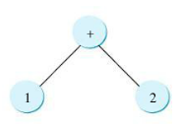
Remembering traversal order
Inorder is 1 + 2
Postorder is 1 2 +
Preorder + 1 2

Slide 36
Tree Traversal, cont.
For example, in the tree above,
the inorder is 45 55 57 59 60 67 100 101 107.
the postorder is 45 59 57 55 67 101 107 100 60.
the preorder is 60 55 45 57 59 100 67 107 101.
the breadth-first traversal is 60 55 100 45 57 67 107 59 101.

Slide 37
The Tree Interface
The Tree interface defines common operations for trees, and the AbstractTree class partially implements Tree.
Tree
AbstractTree

Slide 38
The BinaryTree Class
Let’s define the binary tree class, named BST with A concrete BST class can be defined to extend AbstractTree.
BST

Slide 39
Example: Using Binary Trees
Write a test program that creates a binary tree using BST.
Add strings into the binary tree and traverse the tree in inorder, postorder, and preorder.
TestBST
Run

Slide 40
Tree After Insertions
Inorder: Adam, Daniel George, Jones, Michael, Peter, Tom
Postorder: Daniel Adam, Jones, Peter, Tom, Michael, George
Preorder: George, Adam, Daniel, Michael, Jones, Tom, Peter

Slide 41
Deleting Elements in a Binary Search Tree
Need to first locate the node that contains the element and also its parent node.
Let current point to the node that contains the element in the binary tree and parent point to the parent of the current node.
The current node may be a left child or a right child of the parent node. There are two cases to consider:

Slide 42
Deleting Elements in a Binary Search Tree
Case 1: The current node does not have a left child, as shown in this figure (a). Simply connect the parent with the right child of the current node, as shown in this figure (b).
(a) (b)

Slide 43
Deleting Elements in a Binary Search Tree
For example, to delete node 10 in figure below. Connect the parent of node 10 with the right child of node 10 as shown in part (b).
(a) (b)

Slide 44
Deleting Elements in a Binary Search Tree
Case 2: The current node has a left child.
Let rightMost point to the node that contains the largest element in the left subtree of the current node and parentOfRightMost point to the parent node of the rightMost node, as shown in next figure part (a).
Note that the rightMost node cannot have a right child, but may have a left child.
Replace the element value in the current node with the one in the rightMost node, connect the parentOfRightMost node with the left child of the rightMost node, and delete the rightMost node, as shown in next figure part (b).

Slide 45
Deleting Elements in a Binary Search Tree
Case 2:
(a) (b)

Slide 46

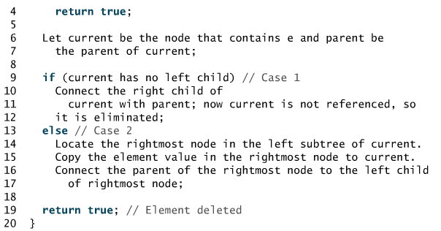
Algorithm for deleting an element

Slide 47
Deleting Elements in a Binary Search Tree
Case 2 example: delete 20
(a) (b)

Slide 48
Examples

Slide 49
Examples

Slide 50
Examples
TestBSTDelete
Run

